Slide 1
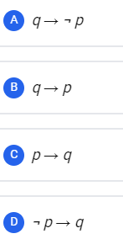
Let p and q be the following propositions:
p: Fail grade can be given.
q: Student scores more than 50% marks.
Consider the statement: “Fail grade cannot be given when student scores more than 50% marks.”
Which one of the following is the CORRECT representation of the above statement in propositional logic?

Slide 2
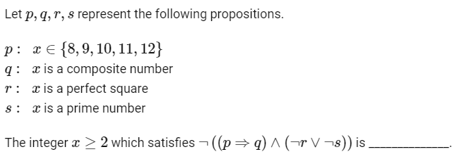

Slide 4



Predicate Logic
Predicate
Predicates are the statements involving variables which are neither True nor False until or unless the values of the variables are specified.
Example: x is even number. (open statement)
5 is an even number - False
6 is an even number - True

Slide 5
Example: Every person, who is 18 years or older, is eligible to vote. (open statement)
Above statement is neither true nor false
It is not a proposition.
But if we specify the name of a person as
Ram is eligible to vote.
Now above statement is a proposition

Slide 6
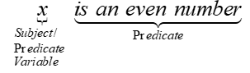
In predicate Logic statement is divided into two parts
Subject (or Predicate variable)
Predicate
Example:
Shorthand Notation: P(x)
Where,
P( ) : is an even number
x : subject

Slide 7
Example 1: Let P(x) denote the statement “ x is greater than 10″. What are the truth values of P(5) and P(11) ?
P(x) : x > 10
P(5) : 5 > 10 (False)
P(11) : 11 > 10 (True)
Example 2: Let R(x, y) denote the statement “ x = y + 1 ”. What is the truth value of the propositions R(1,3) and R(2,1) ?
R(x, y) : x = y + 1
R(1,3) : 1 = 3 + 1 (False)
R(2,1) : 2 = 1 + 1 (True)

Slide 8
Domain (Universe of discourse or simply universe)
The domain of a predicate variables is the set of all possible values that may be substituted in place of variables.
Example: x is even number.
Now, For above predicate, domain will be integers.
Example: Every person, who is 18 years or older, is eligible to vote.
For above predicate, domain will be people’s name.

Slide 9
Quantifiers
Quantifiers are words that refer to quantities such as some, few, many, all, none and indicate how frequently a certain statement is true.
In English, Quantifiers are used to express the quantities without giving exact quantity.

Slide 10
There are two types of quantifier-
Universal Quantifier
Existential Quantifier
Example: Let P(x) be a statement x + 2 > x.
P(x) : x + 2 > x
P(1) : 1+2 > 1 ……True
P(1) : 2+2 > 2 ……True
P(1) : 3+2 > 3 ……True
……
P(x) is true for all values of x.

Slide 11
Example: Let Q(x) be a statement x < 2.
Q(x) : x < 2
Q(1) : 1 < 2 ……(True)
Q(2) : 2 < 2 ……(False)
Q(3) : 3 < 2 ……(False)
There exists some x for which Q(x) is true.

Slide 12
Universal Quantification-
Mathematical statements sometimes assert that a property is true for all the values of a variable in a particular domain, called the domain of discourse. Such a statement is expressed using universal quantification.
The universal quantification of P(x) in the statement
“P(x) for all values of x in the domain”
Notation: $\left.∀xP(x\right)$
$∀$ is called universal quantifier.

Slide 13
Note: It is important to specify domain of discourse. without it, Universal quantification of a statement is not defined
Example:
All the students of class 9th have done their homework.
All the students of class 9th and class 10th have done their homework.

Slide 14
$\left.∀xP(x\right)$ :- For all x P(x)
For every x P(x)
For each x P(x)
For any x P(x)
All of x P(x)
Example: All human beings are mortal.
x : Human beings
P(x) : x is mortal
$\left.∀xP(x\right)$: All human beings are mortal.

Slide 15
2. Existential Quantification-
Some mathematical statements assert that there is an element with a certain property. Such statements are expressed by existential quantification.
Existential quantification can be used to form a proposition that is true if and only if P(x) is true for at least one value of x in the domain.
The existential quantification of P(x) in the statement
“There exist at least one x in the domain such that P(x)”
“There is an x in the domain such that P(x)”.
“For some x P(x)”.
Notation: $\left.∃xP(x\right)$
$∃$ is called existential quantifier.

Slide 16
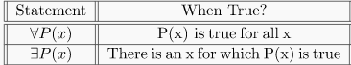
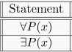
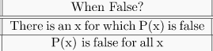

Slide 17
Translating English sentences using quantifiers
All x satisfying P(x) also satisfy Q(x).
This should be written symbolically as
∀x(P(x)⇒Q(x))

Slide 18
Example : The square of any number is not negative.
It can be written as
$$\left.∀x(x^{2}≥0\right)$$
Example : All squares are rectangles.
It can be written as
∀x (x is a square ⇒ x is a rectangle )
Example : Every person who lives in Walla Walla lives in Washington.
It can be written as
∀x (x lives in Walla Walla⇒ x lives in Washington)

Slide 19
Example : If x is negative, so is its cube.
we usually mean "every negative x has a negative cube.
This should be written symbolically as ∀x((x<0)⇒($x^{3}$<0)).

Slide 20
.
.
Some x satisfying P(x) also satisfies Q(x).
This should be written symbolically as
∃x (P(x)∧Q(x))
It may at first seem that "Some x satisfying P(x) satisfies Q(x)'' should be translated as ,∃x(P(x)⇒Q(x)), like the universal quantifier.
Suppose P(x)="x is an apple'' and Q(x)="x is an orange.''
suppose $x_{0}$ is some particular orange.
Then P($x_{0}$)⇒Q($x_{0}$) evaluates to F⇒T, which is T, and the existential quantifier ∃x(P(x)⇒Q(x)) is satisfied.
But The sentence "some apples are oranges'' is certainly false.
Notes:
P(x) : x is an odd no. And Q(x) : x is an even no.

Slide 21
Example : Some professors are republican.
It can be written as
∃x(x is a professor ∧ x is a republican)
Example : some prime number is even.
It can be written as ∃x(x is a prime number ∧ x is even)

Slide 22
)
Example : No democrats are republicans.
It can be written as
∀x (x is a democrat ⇒ x is not a republican).
Example : No triangles are rectangles
It can be written as
∀x (x is a triangle ⇒ x is not a rectangle

Slide 23
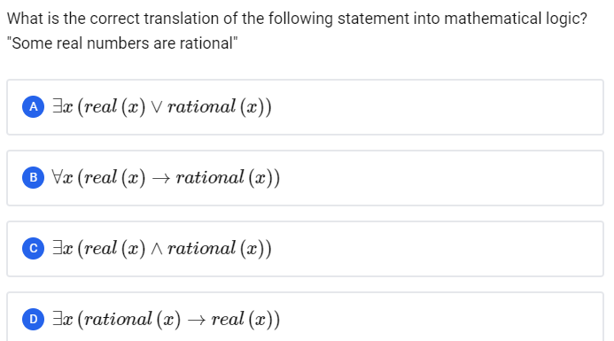
)

Slide 24
GATE-CS-2009
Which one of the following is the most appropriate logical formula to represent the statement? “Gold and silver ornaments are precious”.
The following notations are used: G(x): x is a gold ornament S(x): x is a silver ornament P(x): x is precious
(A) ∀x(P(x)→(G(x)∧S(x))) (B) ∀x((G(x)∧S(x))→P(x)) (C) ∃x((G(x)∧S(x))→P(x) (D) ∀x((G(x)∨S(x))→P(x))
Answer: (D)

Slide 25
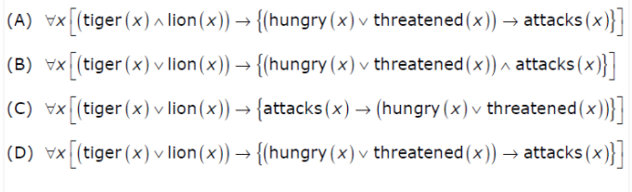
GATE-CS-2006
Which one of the first order predicate calculus statements given below correctly express the following English statement?
Tigers and Lions attack if they are hungry or threatened.
Answer: (D)

Slide 26
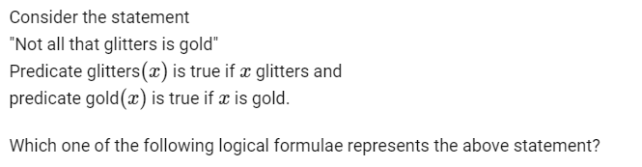
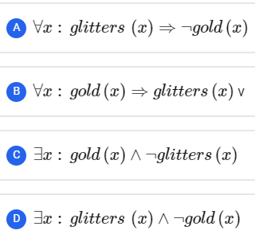

Slide 27
Negating Quantified statements Consider the statement “Every Computer Science Graduate has taken a course in Discrete Mathematics.”
The negation of this statement is “It is not the case that every computer science graduate has taken a course in Discrete Mathematics”
or simply “There is a computer science graduate who has not taken a course in Discrete Mathematics”.
$∀xP(x)$ : Every Computer Science Graduate has taken a course in Discrete Mathematics

Slide 28
The previous statement can be expressed using an existential quantification.
$$\left.∃x¬P(x\right)$$
Thus, we get the following logical equivalence-
$$\left.¬∀xP(x)≡∃x¬P(x\right)$$
Similarly,
$$\left.¬∃xP(x)≡∀x¬P(x\right)$$

Slide 29
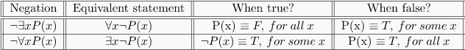
These equivalences are nothing but rules for negations of quantifiers. They are also known as De Morgans’s laws for quantifiers.

Slide 30
Combining laws and equivalences
We can combine the DeMorgan laws for quantifiers and various other equivalences
¬∀x (P(x) → Q(x)) ⇔ ¬∀x (¬P(x) ∨ Q(x))
⇔ ∃x ¬(¬P(x) ∨ Q(x))
⇔ ∃x (¬¬P(x) ∧ ¬Q(x))
⇔ ∃x (P(x) ∧ ¬Q(x))
¬∃x (P(x) ∧ Q(x)) ⇔ ∀x ¬(P(x) ∧ Q(x))
⇔ ∀x (¬P(x) ∨ ¬Q(x))
⇔ ∀x (P(x) → ¬Q(x))

Slide 31
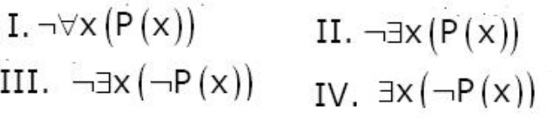
GATE-CS-2009
Which of the above two are equivalent? (A) I and III (B) I and IV (C) II and III (D) II and IV
Answer: (B)

Slide 32
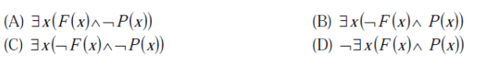
GATE CS 2013
What is the logical translation of the following statement?
“None of my friend are perfect”
(A) A (B) B (C) C (D) D
Answer: (D)

Slide 33
Nested Quantifiers
Definition
It is possible to use two quantifiers such that one quantifier is within the scope of the other one.
In such cases the quantifiers are said to be nested.

Slide 34
For example, $\left.∀x ∃y(x+y=0\right)$
The above statement is read as “For all x, there exists a y, such that x + y = 0.
$\left.∀x ∃y(x+y=0\right)$ $\left.⇒∀xP(x\right)$

Slide 35
Different combinations of Nested Quantifiers
$$\left.∀x∀yQ(x,y\right)$$
$$\left.∀x∃yQ(x,y\right)$$
$$\left.∃x∀yQ(x,y\right)$$
$$\left.∃x∃yQ(x,y\right)$$
Note: The relative order in which the quantifiers are placed is important unless all the quantifiers are of the same kind i.e. all are universal quantifiers or all are existential quantifiers.

Slide 36
Order of Quantifiers.
It is important to pay attention to the order of quantifiers. Changing the order can completely change the meaning.
For example, the formula
∀x ∈ $ℤ$(∃y ∈ $ℤ$ (x + y = 0)) is true,
because we can take y to be −x.
On the other hand,
∃y ∈ $ℤ$(∀x ∈ $ℤ$ (x + y = 0)) not true,
Because there is no number with the property that no matter what we add to it, we get 0!

Slide 37
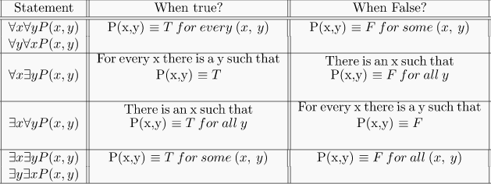

Slide 38
Example to convert a statement into a nested quantifiers formula: “There is a person in this lecture who has taken at least one course in Discrete Maths.”
Here x and y are the person and the course and their respective quantifiers are attached in front of them.
Write it down as-
For some x pupil, there exist a course in Discrete Maths, such that x has taken y.
∃x ∃y P (x, y), where P (x, y) is "x has taken y".

Slide 39
Example
Assume P(x, y, z) is (x + y = z).
∀x ∀y ∃z P(x, y, z) domain: real numbers
Translates to- For all real numbers x and y there is a real number z such that x + y = z (True)
∃z ∀x ∀ y P(x, y, z) domain: real numbers There is a real number z such that for all real numbers x and y, x + y = z (False)

Slide 40
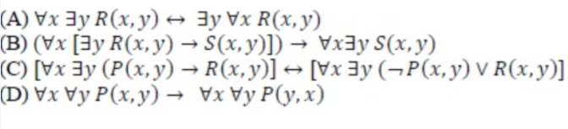
GATE-CS-2015 (Set 2)
Which one of the following well formed formulae is a tautology?
Answer: (C)

Slide 41
Negation of nested quantifiers:
To negate a sequence of nested quantifiers, we change each quantifier in the sequence to the other type and then negate the predicate.
So the negation of ∀x ∃y : P(x, y) is ∃x ∀y : ~P(x, y)
Example- “ ∃x at Cornell, x is at least 18 years old.”
To disagree with this, you’re negating the statement by flipping the ∃ to ∀ and then negating the predicate:
“ ∀x at Cornell such that x is not at least 18 years old.”

Slide 42
Negation of $\left.∀x∃y (xy=1\right)$

Slide 43
GATE CS 2010
Suppose the predicate F(x, y, t) is used to represent the statement that person x can fool person y at time t.
which one of the statements below expresses best the meaning of the formula ∀x∃y∃t(¬F(x, y, t))?
(A) Everyone can fool some person at some time (B) No one can fool everyone all the time (C) Everyone cannot fool some person all the time (D) No one can fool some person at some time
Answer: (B)

Slide 44
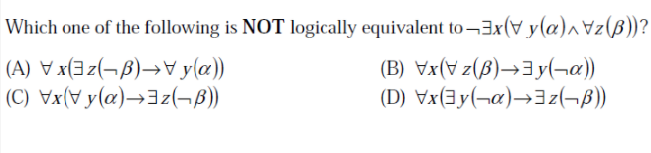
GATE CS 2013
Answer: (A) (D)
$$\left.∀x(α)=¬∃x(¬α\right)$$

Slide 45
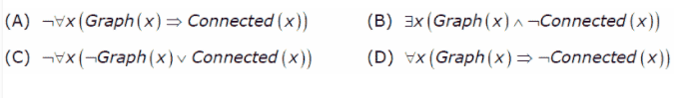
GATE-CS-2007
Let Graph(x) be a predicate which denotes that x is a graph. Let Connected(x) be a predicate which denotes that x is connected. Which of the following first order logic sentences DOES NOT represent the statement: “Not every graph is connected”?
Answer: (D)

Slide 46

Thank you

